Slide 1
Hive

Slide 2
Agenda
Introduction to Hive
Hive architecture & components
Metastore
Thrift
Hive clients
Data types
Hive tables
File formats and record formats (SerDe)
HiveQL – DDL
HiveQL – DML
Notes:
Refer - https://docs.qubole.com/en/latest/user-guide/engines/hive/apache-hive.html

Slide 3
Agenda
Partitioning & bucketing
ACID transactions in Hive – UPDATE, DELETE
Configuration
Locks in Hive
Views & indexes
Storage handlers for NoSQL
Hive integration with other frameworks
Notes:
Refer - https://docs.qubole.com/en/latest/user-guide/engines/hive/apache-hive.html

Slide 4
Introduction
File
Split
Map
Partition
Sort
Copy
Merge
Reduce
Output
MapReduce
Mapper
Reducer
SQL
Split
Map
Reduce
Split
Map
Reduce
MapReduce
MapReduce
MapReduce
MapReduce
MapReduce
MapReduce
MapReduce

Slide 5
Introduction
Hive was built on top of Hadoop for querying, summarizing, and analyzing large data sets using a SQL-like interface.
Hive Query Language (HiveQL).
It is noted for bringing the familiarity of relational technology to Big Data processing with Hive Query Language.
HiveQL gets converted to MapReduce jobs and runs on Hadoop.
MapReduce is slow.
HiveQL (SQL Like)
MapReduce
Cluster

Slide 6
Tez
Execution engine for Hive. Replacement of MapReduce.
Complex flow of MapReduce jobs

Slide 7
Tez
Multiple MapReduce jobs can be replaced by single Tez job.
Directed Acyclic Graph (DAG)
Hive queries gets converted to Tez DAGs.
Hive in EMR runs on Tez.
hive.execution.engine.
Cluster
HiveQL
Tez DAG
YARN

Slide 8
Hive Architecture
Hive Clients
Hive Services
Thrift Application
Metastore
Database
Hive Driver
Metastore
Hive CLI
JDBC Application
Filesystem
Hive Server2
Hadoop Cluster (EMR)
Hive Web UI
Execution Engine
ODBC Application
EMR

Slide 9
Hive Components
Hiveserver2 – Runs Hive as a server exposing Thrift service. Enables access from programming languages that support Thrift, JDBC and ODBC.
CLI – Command line interface for Hive. Hive shell.
Web UI – Alternative of Hive CLI. It provides a web-based GUI for executing Hive queries and commands.
Hive Metastore (HMS) – Stores all the structure information of various tables and partitions.
Execution Engine - Optimizer generates logical plan in the form of DAG of Tez tasks or MapReduce tasks and HDFS tasks.
Filesystem – Communicates with various file formats and record formats.
Beeline – JDBC based command line shell.

Slide 10
Hive Metastore (HMS)
Why do we need metastore?
Central repository for Hive metadata.
Two components:
Service
Data storage
Types of metastores
Embedded metastore – Derby
Local metastore
Driver
Metastore
Derby
Embedded metastore
Driver
Metastore
MySQL
Driver
Metastore
Local metastore
Notes:
We will be creating tables, views etc out of large datasets like parquet, avro, orc etc. We need a permanent place to store the definition of these structures.

Slide 11
Hive Metastore (HMS)
Why do we need metastore?
Central repository for Hive metadata.
Two components:
Service
Data storage
Types of metastores
Embedded metastore – Derby
Local metastore
Remote metastore
Driver
Metastore
MySQL /
AWS Glue
Driver
Metastore
Remote server
Remote metastore
Notes:
We will be creating tables, views etc out of large datasets like parquet, avro, orc etc. We need a permanent place to store the definition of these structures.

Slide 12
Schema on Read
Write data
Null
Data
Traditional database (schema on write)
Schema is enforced at write time.
If data does not conform to schema, it is rejected.
Hive (schema on read)
Data is not verified when loaded, but when it is read.
If data does not conform to schema while reading, NULL is returned.
No
Yes
Schema
Schema
No
Yes
Reject
Storage
Read data

Slide 13
Hive CLI on EMR

Slide 14
Data Types
Numeric type
TINYINT, SMALLINT, INT, BIGINT
FLOAT, DOUBLE
DECIMAL(p, s), NUMERIC(p, s)
Date/Time type
TIMESTAMP – YYYY-MM-DD HH:MM:SS.fffffffff
DATE – YYYY-MM-DD
INTERVAL
String type
STRING
VARCHAR(n = 1-65535)
CHAR(n = 1-255)

Slide 15
Data Types
Complex type
Arrays - ARRAY<data_type>.
Maps - MAP<col_name, data_type, … >.
STRUCT<col_name: data_type, col_name: data_type … >

Slide 16
Databases & Tables
File
Load
Database
Table
CREATE TABLE
Managed table – Data lifecycle is managed by Hive.
External table – Hive does not own the data.
Temporary table – Tables are visible to the current session only.
Managed Table
HDFS
File
External Table
Point to location

Slide 17
File/Storage Format
CREATE TABLE … STORED AS <file_format> … ROW FORMAT <row_format>
Supported file formats
Text File
SequenceFile
Parquet
Avro
ORC
RCFile
Custom file formats using INPUTFORMAT and OUTPUTFORMAT

Slide 18
File/Storage Format
CREATE TABLE … STORED AS <file_format> … ROW FORMAT <row_format>
SEQUENCEFILE – Stored as compressed Sequence File.
TEXTFILE – Stored as plain text file.
RCFILE – Stored as record columnar file format.
ORC – Stored as ORC format. Supports ACID transactions.
PARQUET – Stored as Parquet columnar format.
AVRO – Stored as Avro file format.
JSONFILE – Stored as JSON files.
INPUTFORMAT input_format_classname OUTPUTFORMAT output_format_classname - Custom file format.

Slide 19
Record/Row Format (SerDe)
Input file with records
Read records one by one from file
Convert each record into a Java object
Write to Hive table
Serialize each record objects
Serialize based on row format - SerDe
Read from Hive table
Serialized record
Deserialize - SerDe
Show user

Slide 20
Record/Row Format (SerDe)
Native SerDe
“STORED AS” does not need explicit row format to be mentioned.
Hive SerDe library - org.apache.hadoop.hive.serde2
JSON - ROW FORMAT SERDE 'org.apache.hive.hcatalog.data.JsonSerDe' STORED AS TEXTFILE
CSV - ROW FORMAT SERDE 'org.apache.hadoop.hive.serde2.OpenCSVSerde' STORED AS TEXTFILE
Custom SerDe
Stored as parquet, rcfile, orc, avro, sequencefile does not need ROW FORMAT to be mentioned. Row format is controlled by the file format itself.

Slide 21
Record/Row Format (SerDe)
CREATE TABLE de_test
ROW FORMAT SERDE ‘org.apache.hadoop.hive.serde2.avro.AvroSerDe’
STORED AS
INPUTFORMAT ‘org.apache.hadoop.hive.ql.io.avro.AvroContainerInputFormat’
OUTPUTFORMAT ‘org.apache.hadoop.hive.ql.io.avro.AvroContainerOutputFormat’

Slide 22
Create Table
CREATE TABLE table_name
CREATE EXTERNAL TABLE table_name
CREATE TEMPORARY TABLE table_name
STORED AS file_format
ROW FORMATE SERDE
LOCATION distributed_storage_path
TBLPROPERTIES ( … )
PRIMARY KEY (col_name, … )

Slide 23
Hive Write Path – Service view
Metastore database
Create table
Metastore Service
Metastore database
Insert Data
Metastore Service
Filesystem Service
HDFS

Slide 24
Hive Read Path – Service view
Metastore database
Read Data
Metastore Service
Filesystem Service
HDFS

Slide 25
Hive hands-on

Slide 26
Table Partitioning
car_sales_data
model_yr = 2021
model_yr = 2022
model_yr = 2023
model_yr = 2024
Partition Column
color=r
color=b
color=y
color=b
color=y
color=r
color=r
color=b
data
data
data
data
data
data
data
data

Slide 27
Table Partitioning – Managed Tables
Store different data (based on columns) in different locations.
Separate data directory is created for each distinct value combination in the partition columns.
Faster queries by partition pruning.
WHERE clause should contain the partition column. Partition Filters.
CREATE TABLE table_name ( ... )
PARTITIONED BY (col_name data_type, col_name data_type, ... );
ALTER TABLE table_name ADD PARTITION (part_col = value, part_col = value, … );
SHOW PARTITIONS table_name;
DESCRIBE EXTENDED table_name;
hive.mapred.mode=strict|nonstrict

Slide 28
Table Partitioning – External Tables
CREATE EXTERNAL TABLE table_name ( ... )
PARTITIONED BY (col_name data_type, col_name data_type, ... );
LOCATION clause is not needed while defining the table.
ALTER TABLE statement is used to add each partition separately
Value for each partition key must be specified.
ALTER TABLE table_name ADD PARTITION (part_col = value, part_col = value, … ) LOCATION ‘dir_location’;

Slide 29
Table Partitioning - Static
Static partitioning.
Manual partitioning.
Data files are loaded individually for each partition.
Correct data has to be loaded in correct partition. <file> should contain data corresponding to that partition.
Takes less time to load.
hive.mapred.mode has to be “strict”.
WHERE clause should be used to limit the partition.
CREATE EXTERNAL TABLE <table_name> ( ... )
PARTITIONED BY (model_yr INT)
...;
LOAD DATA ... <file> INTO TABLE car_sales_data PARTITION (model_yr=2023);
LOAD DATA ... <file> INTO TABLE car_sales_data PARTITION (model_yr=2022);

Slide 30
Table Partitioning - Dynamic
set hive.exec.dynamic.partition=true;
set hive.exec.dynamic.partition.mode=nonstrict;
Partitions are created on the fly.
INSERT command can be used to load data, which will be put into their corresponding partition automatically.
Takes more time to load.
CREATE EXTERNAL TABLE <table_name> ( ... )
PARTITIONED BY (model_yr INT)
...;
INSERT INTO table PARTITION (column) ...

Slide 31
Table Partitioning - Dynamic
hive.exec.dynamic.partition = true
Needs to be set to true to enable dynamic partition inserts.
hive.exec.dynamic.partition.mode = strict|nonstrict
In strict mode, the user must specify at least one static partition in case the user accidentally overwrites all partitions, in nonstrict mode all partitions are allowed to be dynamic.
hive.exec.max.dynamic.partitions = n
Maximum number of dynamic partitions allowed to be created in total.
hive.error.on.empty.partition = true|false
Whether to throw an exception if dynamic partition insert generates empty results.

Slide 32
Bucketing
Buckets divides tables or partitions into further sub-divisions.
CREATE TABLE table_name (product_id INT, sales_person_id STRING, ... )
CLUSTERED BY (product_id) INTO 4 BUCKETS;
CREATE TABLE table_name (product_id INT, sales_person_id STRING, ... )
PARTITIONED BY(model_year)
CLUSTERED BY (product_id) INTO 4 BUCKETS;
Bucket No. = hash(clustered_col) % No. of partitions.
Bucket No. = hash(product_id) % 4.

Slide 33
Bucketing
CLUSTERED BY (product_id) INTO 4 BUCKETS;
model_yr = 2021
bucket1
bucket2
bucket3
bucket4
model_yr = 2022
bucket1
bucket2
bucket3
bucket4

Slide 34
Partitioning & Bucketing hands-on

Slide 35
LOAD
LOAD
Table
File
hive.metastore.warehouse.dir
Copy
Local Filesystem or HDFS
No Transformation
Direct Copy

Slide 36
INSERT
INSERT INTO ... – Append to the table.
INSERT OVERWRITE … - Overwrite existing data.
Table or Partition
Transformation
Read from CSV and insert into ORC, Parquet etc.
INSERT INTO … SELECT … FROM …

Slide 37
SELECT
[WITH CommonTableExpression (, CommonTableExpression)] SELECT [ALL | DISTINCT] select_expr, select_expr, ... FROM table_reference [WHERE where_condition] [GROUP BY col_list] [ORDER BY col_list] [CLUSTER BY col_list | [DISTRIBUTE BY col_list] [SORT BY col_list] ] [LIMIT [offset,] rows]
ORDER BY – Order is maintained for the entire result set.
SORT BY – Ordering rows within a reducer. Partially ordered dataset.
Local Mode – Read from files directly.

Slide 38
ACID Transactions - UPDATE, DELETE
UPDATE & DELETE statements.
BEGIN, COMMIT and ROLLBACK are not supported.
Only ORC file format is supported.
Must be bucketed.
Have to set Hive transaction manager.
SET hive.txn.manager = org.apache.hadoop.hive.ql.lockmgr.DbTxnManager;
SET hive.support.concurrency = true;
SET hive.enforce.bucketing = true;
CREATE TABLE … TBLPROPERTIES (“transactional”=“true”);

Slide 39
ACID Transactions, UPDATE, DELETE
Base Files
Delta Files
Compaction
Minor compaction – Takes a set of existing delta files and rewrites them to a single delta file per bucket.
Major compaction – Takes one or more delta files and the base file for the bucket and rewrites them into a new base file per bucket.
Bucket 1
Delta file 1
Bucket 2
Delta file 2

Slide 40
Materialized View
Similar to a table.
Stores results of a query.
Refresh the content of MV to keep it up-to-date with the changes in the table.
Refresh is incremental by default, falls back to rebuild if not possible.
INSERT – Incremental
UPDATE – Full rebuild
DELETE – Full rebuild
CREATE MATERIALIZED VIEW <name> …
PARTITIONED ON (col_name, ...)
CLUSTERED ON (col_name, ...)
ROW FORMAT <row_format>
FILE FORMAT <file_format>
LOCATION <location>
AS <query>
ALTER MATERIALIZED VIEW <name> REBUILD;

Slide 41
Index
Indexes are removed since 3.0
View
Similar to view in RDBMS.
CREATE VIEW AS SELECT …

Slide 42
JOINs
INNER JOIN
LEFT | RIGHT OUTER JOIN
SELECT a.*
FROM a JOIN b ON (a.id = b.id AND a.department = b.department)
SELECT a.* FROM a LEFT OUTER JOIN b ON (a.id = b.id)
SELECT a.val, b.val, c.val
FROM a JOIN b ON (a.key = b.key1)
JOIN c ON (c.key = b.key2)

Slide 43
Hive Configuration Parameters
hive.mapred.mode=strict - Full table scans are rejected and ORDER BY needs a LIMIT clause.
hive.exec.parallel=true|false - Whether to execute jobs in parallel. Applies to MapReduce jobs that can run in parallel.
hive.exec.parallel.thread.number=8 - How many jobs at most can be executed in parallel.
hive.enforce.bucketing=true - While inserting into the table, bucketing is enforced.
hive.enforce.sorting=true - while inserting into the table, sorting is enforced.
hive.exec.dynamic.partition=true – Enable dynamic partitioning.
hive.exec.dynamic.partition.mode=strict
hive.exec.mode.local.auto=true – Whether local mode should be used in SELECT.

Slide 44
Hive Configuration Parameters
hive.exec.temporary.table.storage - Define the storage policy for temporary tables.
hive.default.serde=org.apache.hadoop.hive.serde2.lazy.LazySimpleSerDe - The default SerDe Hive will use for storage formats that do not specify a SerDe (TextFile, RCFile).
hive.default.fileformat=TextFile - Default file format for CREATE TABLE statement. Options are TextFile, SequenceFile, RCfile, ORC, and Parquet.
hive.metastore.warehouse.dir=/user/hive/warehouse - Location of default database for the warehouse.
hive.execution.engine=mr | tez | spark
mapred.reduce.tasks - The default number of reduce tasks per job.
hive.merge.tezfiles=true - Merge small files at the end of a Tez DAG.

Slide 45
Hive Configuration Parameters
hive.txn.manager=org.apache.hadoop.hive.ql.lockmgr.DbTxnManager - Turns on Hive transactions.
hive.compactor.initiator.on=true
hive.compactor.cleaner.on=true
hive.compactor.worker.threads=4 - How many compactor worker threads to run on this metastore instance.
hive.support.concurrency=true - Whether Hive supports concurrency or not. A ZooKeeper instance must be up and running for the default Hive lock manager to support read-write locks.
hive.enforce.bucketing=true
hive.exec.dynamic.partition.mode=nonstrict
hive.lock.manager=org.apache.hadoop.hive.ql.lockmgr.zookeeper.ZooKeeperHiveLockManager

Slide 46
Hive Configuration Parameters
hive.hwi.war.file
hive.hwi.listen.host
hive.hwi.listen.port
File where configuration parameters are stored – hive-site.xml

Slide 47
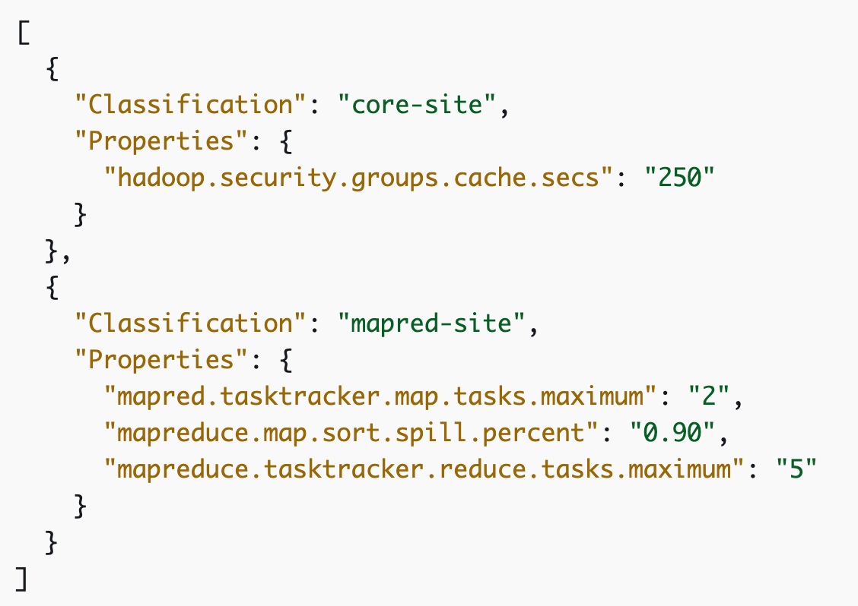
Configuration on EMR
By supplying configuration object (JSON file).
Classification and properties.
Classification maps to application specific configuration file.
“hive-site” classification maps to “hive-site.xml” configuration file.

Slide 48
EXPLAIN Statement
Check how Hive will execute a query.
EXPLAIN [EXTENDED | CBO | AST | DEPENDENCY | AUTHORIZATION | LOCKS | VECTORIZATION | ANALYZE] <query>
Query gets converted into a sequence of stages.
Map/Reduce stages
Metastore operations
Filesystem operations
There are dependencies between different stages of the plan.

Slide 49
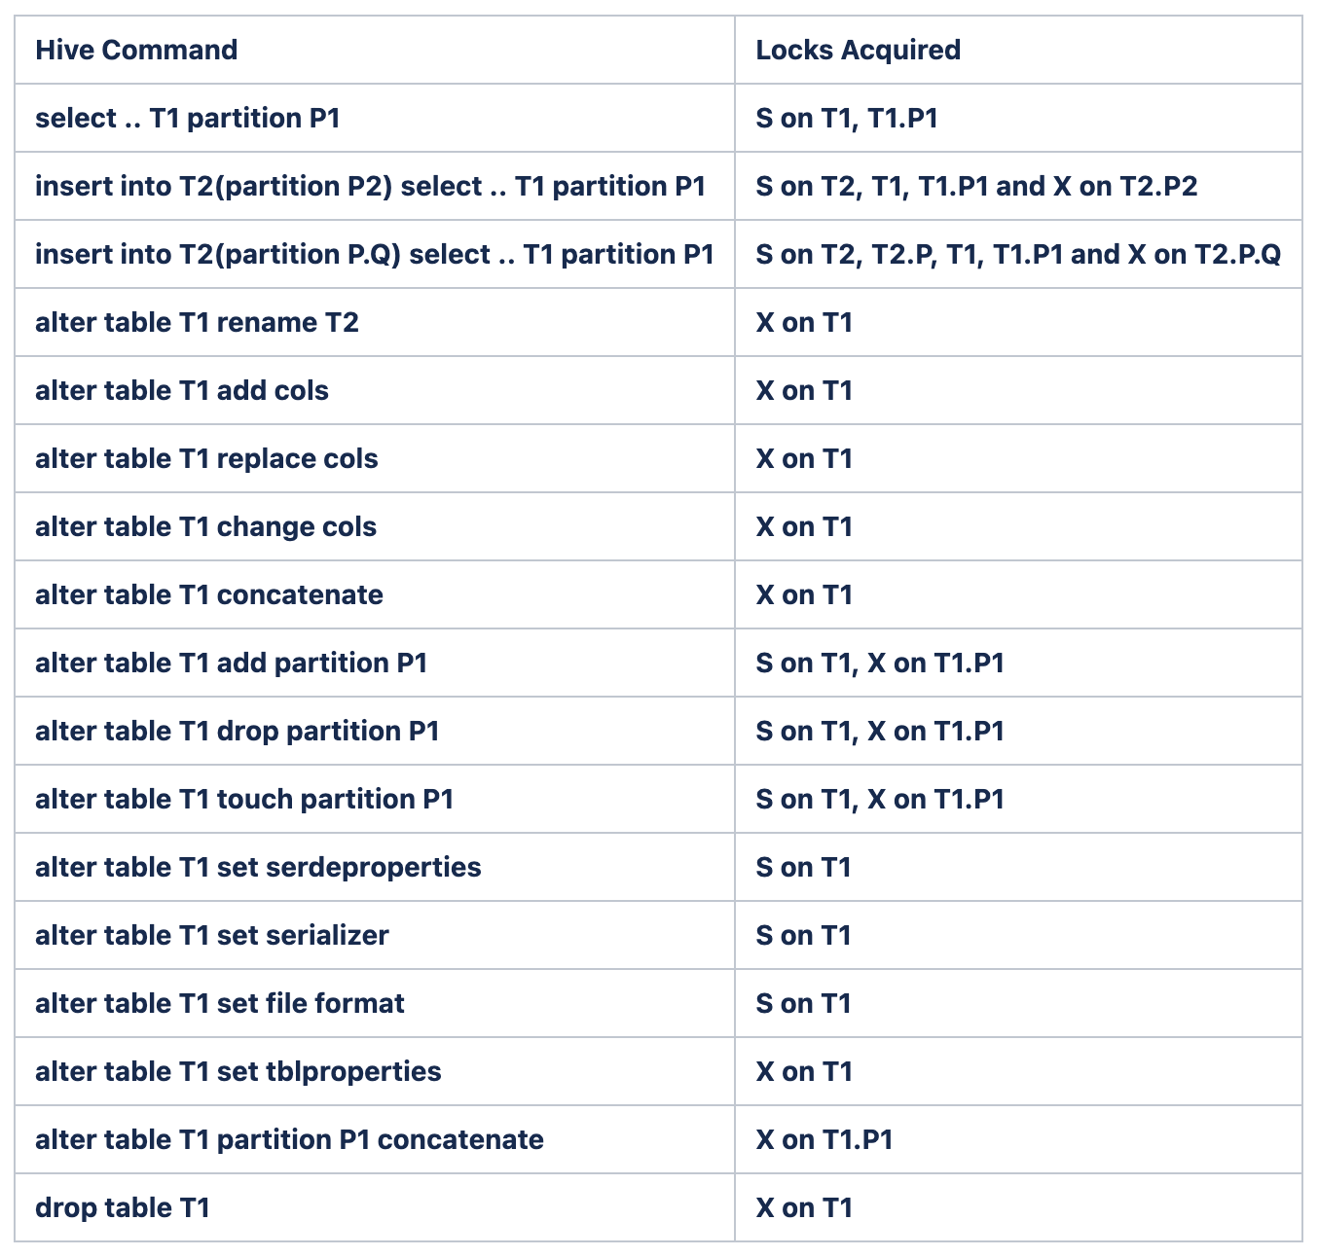
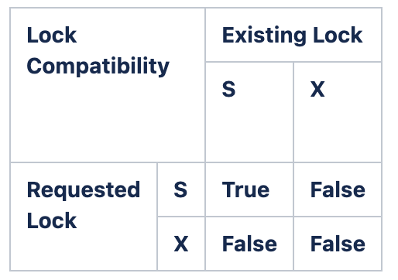
Lock Modes
Shared – While reading
Exclusive – All other operations

Slide 50
Storage Handlers
HiveStorageHandler
Used to connect to NoSQL databases like HBase, Cassandra, DynamoDB etc.
STORED BY HBaseStorageHandler. TBLPROPERTIES
External Table
STORED BY CassandraStorageHandler. SERDEPROPERTIES (column mappings).
STORED BY DynamoDBStorageHandler. Column mapping is done is TBLPROPERTIES.
Custom InputFormat
Custom SerDe
Custom OutputFormat
NoSQL database storage system
NoSQL database

Slide 51
Hive Integrations
HBase
Cassandra
DynamoDB
Druid
Kudu
Spark

Slide 52
Thank You!

